Slide 1
CS 106A, Lecture 1 Welcome to CS 106A!
suggested reading:
Course Information handout
Karel, Ch. 1-2

Slide 2

Plan For Today
Introduction
Course Policies
Meet Karel the Robot

Slide 3
Plan For Today
Introduction
Course Policies
Meet Karel the Robot

Slide 4


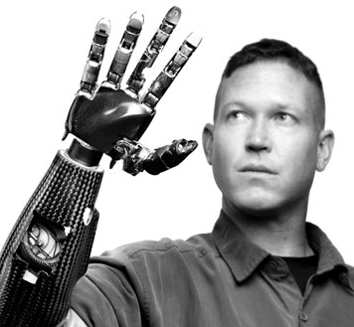
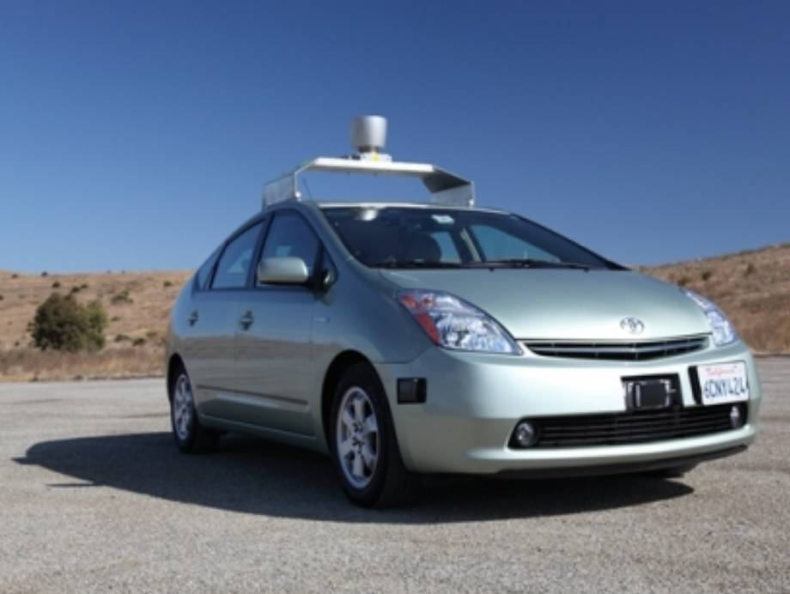
What is Computer Science?
The art of using computing to solve complex problems.
Specify instructions that computers execute, usually in a programming language
Applicable to art, medicine, mathematics, philosophy, and more
Touches many aspects of our daily lives
Notes:
Super happy you’re all here, and that we get to introduce you to computer science for the first time.

Slide 5
Computing is Everywhere
> 3.5B users of the internet (internetlivestats.com)
39% owned a smartphone in 2016 (strategyanalytics.com)
A computer recently defeated the world-champion Go player
Machine translation has taken dramatic leaps in the past year
Notes:
I witnessed at Google!

Slide 6
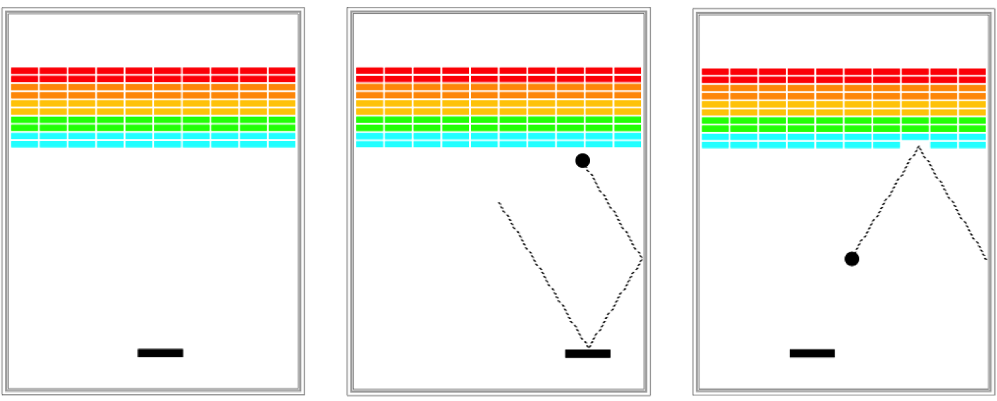
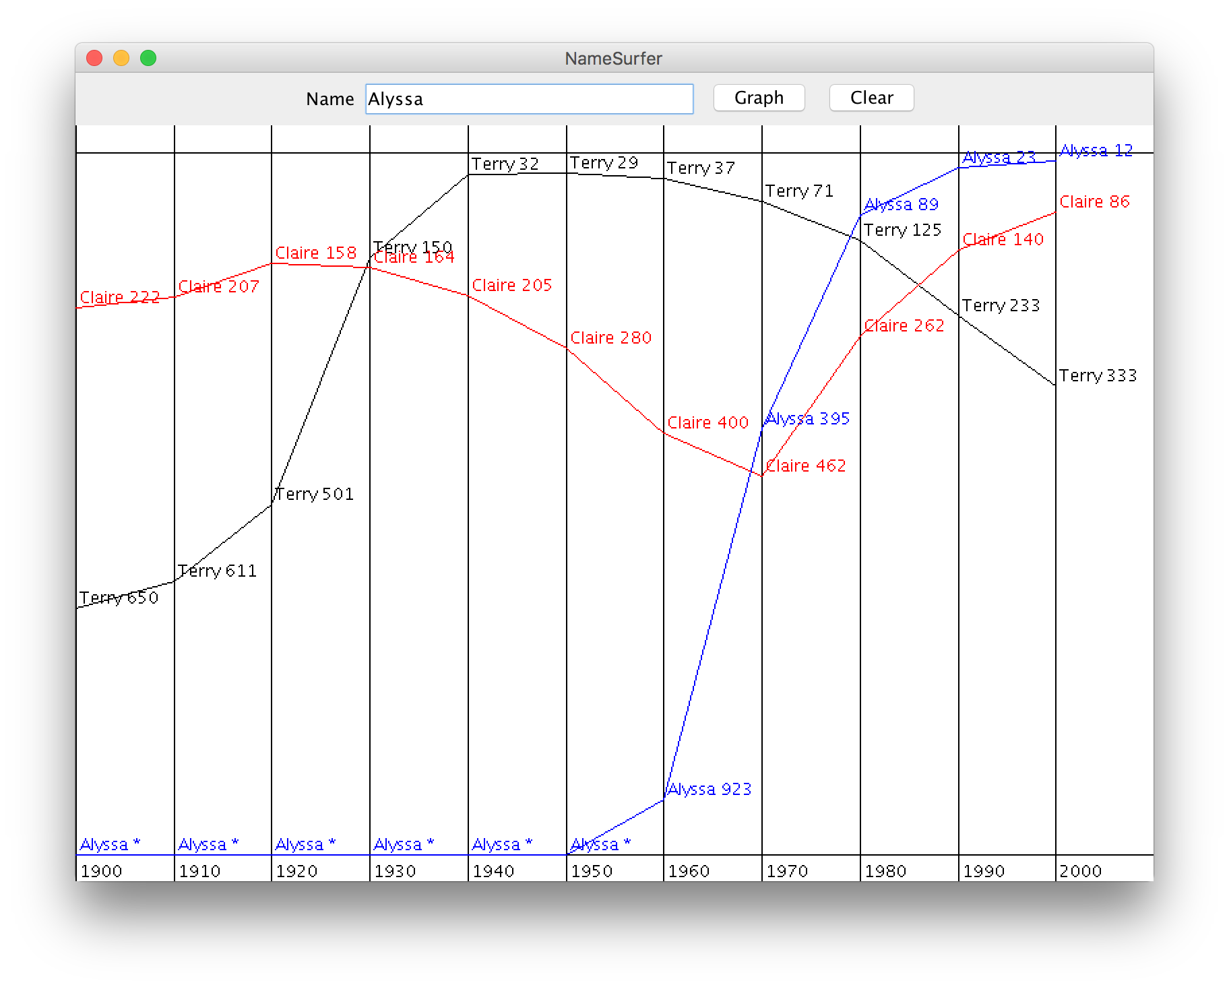
What is CS 106A?
Programming Methodology
Focusing on computational problem solving, not syntax
Uses the Java programming language
No former programming experience required!
Topics include:
Karel the Robot
Text-based programs
Graphics and animation
Games
And more…
Notes:
Why “Methodology”? – we want to teach good software engineering principles – more than just programming.
Writing a program is like writing an essay
- need a language (Java)
- knowing the language doesn’t make you a good essay writer
Lots of support to learn how to write good programs

Slide 7
Course Website
cs106a.stanford.edu

Slide 8
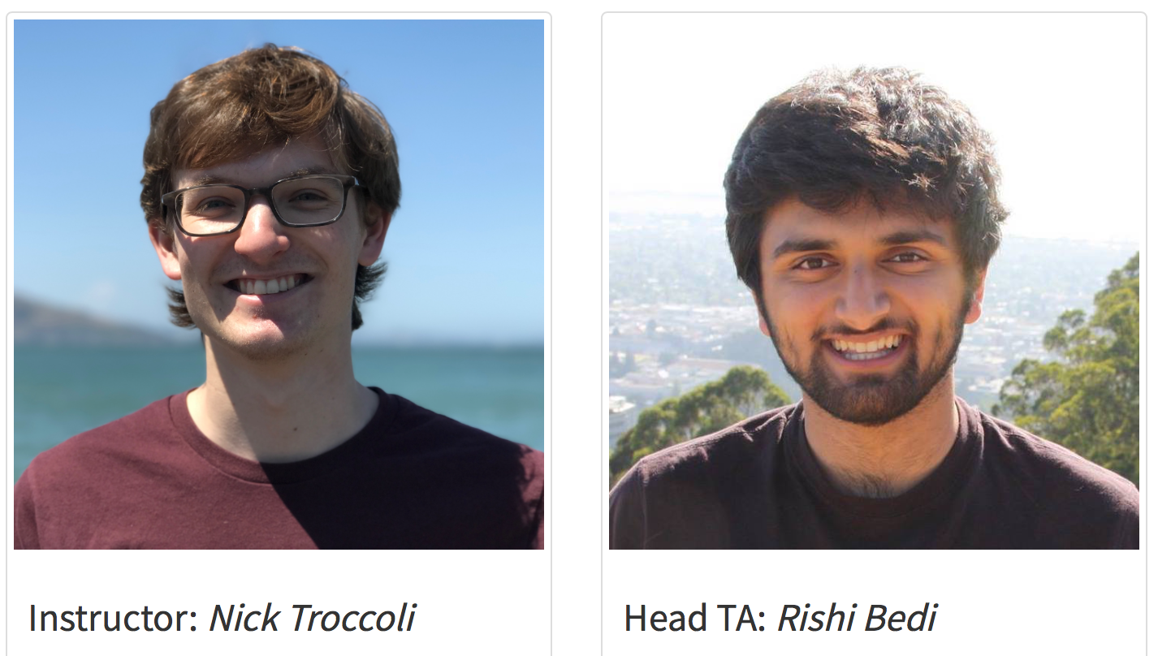
Nice to meet you!
Notes:
I want to introduce my right-hand man

Slide 9
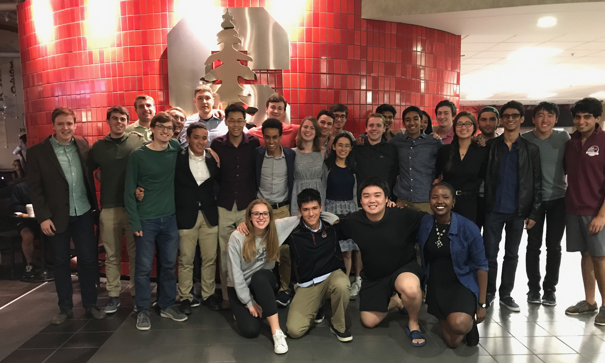
Section Leaders
Helpful undergraduate assistants who will:
run your discussion section each week
grade your homework assignments and exams
help you when you have questions
... and much more
Notes:
But that’s not nearly everyone – we also have 22 awesome section leaders!

Slide 10
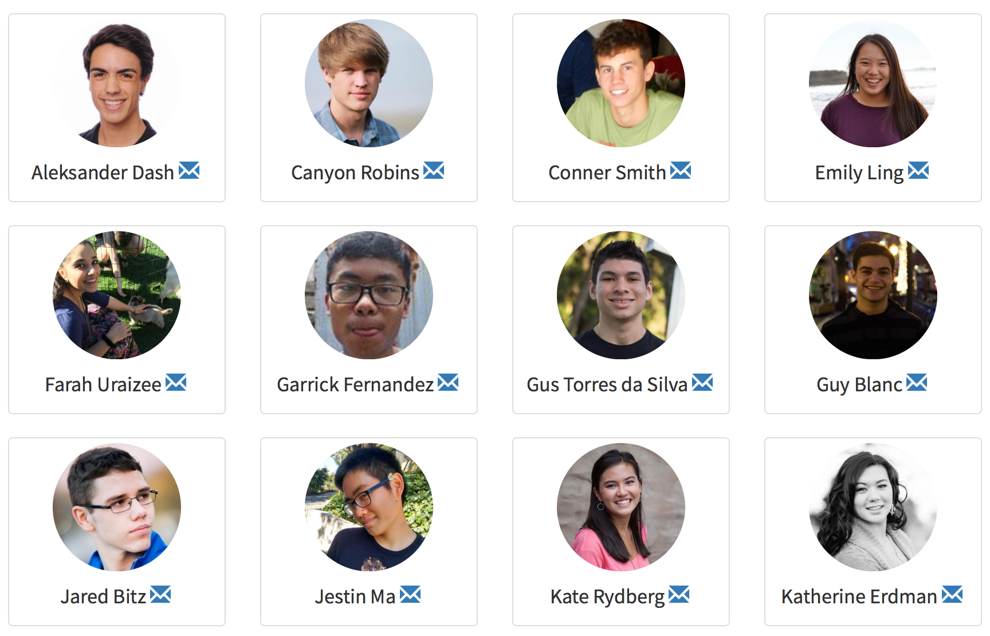
Nice to meet you!

Slide 11
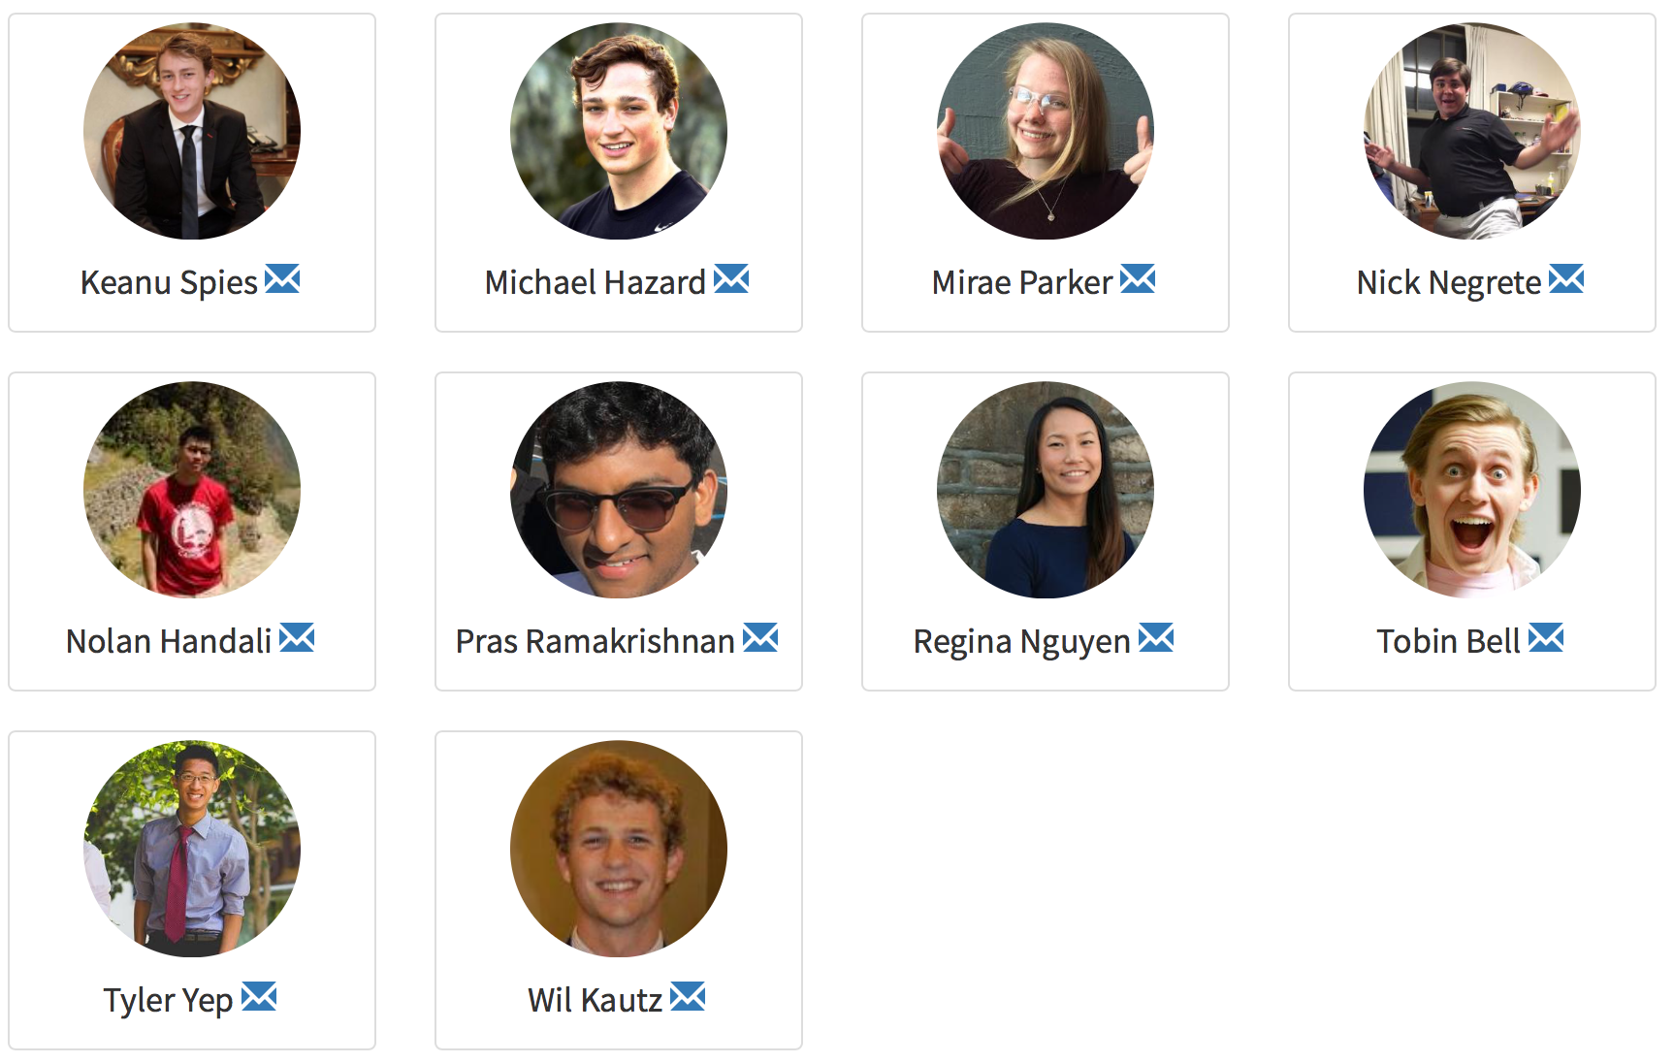
Nice to meet you!

Slide 12
Plan For Today
Introduction
Course Policies
Meet Karel the Robot

Slide 13
Units
Matriculated Stanford grad?
No
Yes
5!
3-5!

Slide 14
Course Website
cs106a.stanford.edu

Slide 15

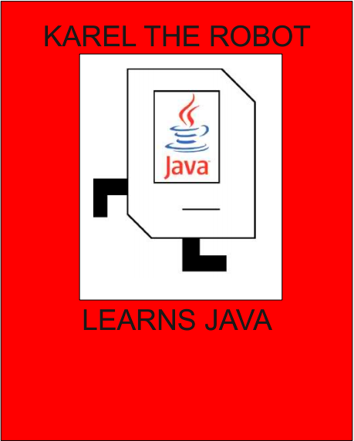
Textbooks
The Art & Science of Java, by Eric Roberts
written here at Stanford; tailored to this course; a valuable reference
usable on open-book (closed-note) exams
available on reserve at library
Karel the Robot Learns Java, coursereader (35 pages)
used this and next week as we introduce coding
usable on open-book (closed-note) exams
Free PDF available online

Slide 16
Grading
****** 45% Programming assignments
* 10% Section Participation
** 15% Midterm Exam
**** 30% Final Exam

Slide 17
Grading
****** 45% Programming assignments
* 10% Section Participation
** 15% Midterm Exam
**** 30% Final Exam

Slide 18
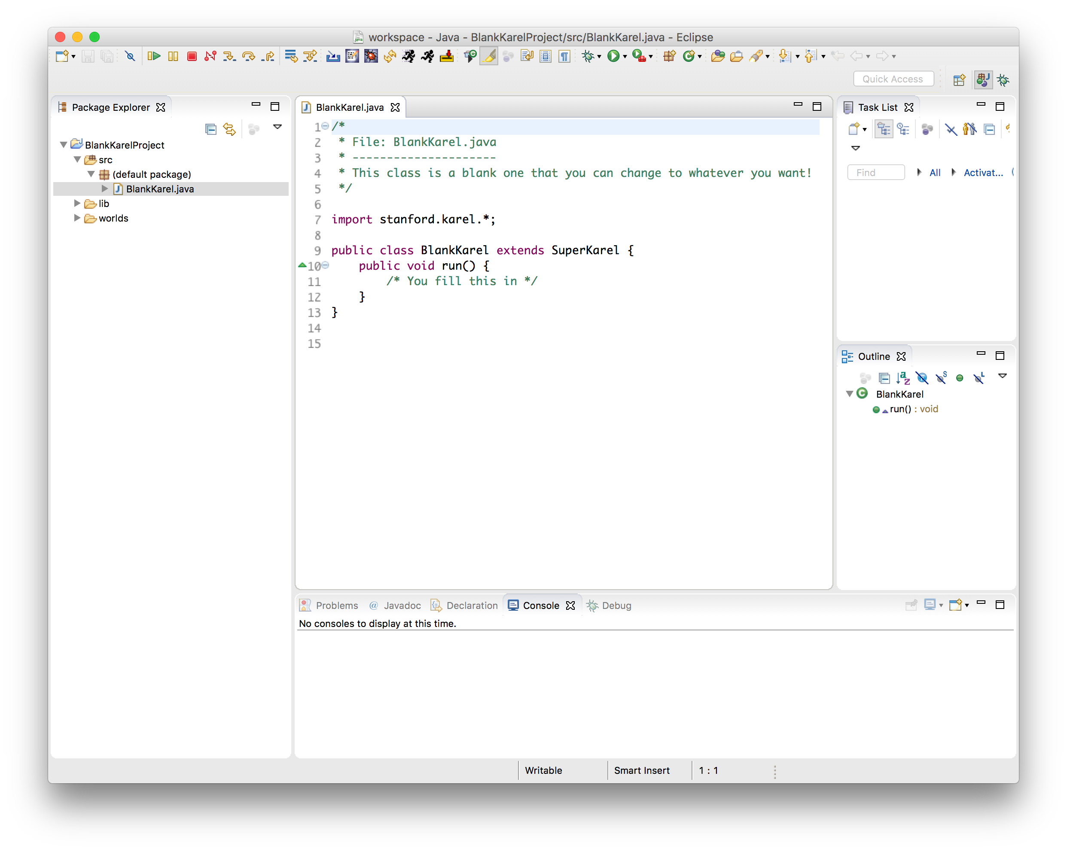
Programming Assignments
6 programming assignments (some individual, some in pairs), completed using Eclipse
graded on functionality (behavior) and style (elegance)
Interactive grading sessions every week
grading scale is divided into "buckets”
Free software, available on course website
Homework: set up Eclipse!
Come to LaIR this Wed. 7-11PM for troubleshooting
Notes:
Later weighted more heavily
How much work? Roughly 10 hours a week
How do we grade? Focus on functionality and style (methodology), but people get wrapped up with numeric scores.
We want to go back to happier times…

Slide 19
The Bucket System
√ | satisfactory; meets requirements, maybe a few issues

Slide 20
The Bucket System
√+ | Well done; satisfies all assignment requirements
√ | satisfactory; meets requirements, maybe a few issues

Slide 21
The Bucket System
√+ | Well done; satisfies all assignment requirements
√ | satisfactory; meets requirements, maybe a few issues
√- | Problems serious enough to fall short of assignment requirements

Slide 22
The Bucket System
+ | Exceeds expectations; often reflects additional work
√+ | Well done; satisfies all assignment requirements
√ | satisfactory; meets requirements, maybe a few issues
√- | Problems serious enough to fall short of assignment requirements

Slide 23
The Bucket System
+ | Exceeds expectations; often reflects additional work
√+ | Well done; satisfies all assignment requirements
√ | satisfactory; meets requirements, maybe a few issues
√- | Problems serious enough to fall short of assignment requirements
- | Extremely serious problems, a little effort and understanding

Slide 24
The Bucket System
++ | Absolutely fantastic submission (very rare)
+ | Exceeds expectations; often reflects additional work
√+ | Well done; satisfies all assignment requirements
√ | satisfactory; meets requirements, maybe a few issues
√- | Problems serious enough to fall short of assignment requirements
- | Extremely serious problems, a little effort and understanding
Notes:
Makes us weep!

Slide 25
The Bucket System
++ | Absolutely fantastic submission (very rare)
+ | Exceeds expectations; often reflects additional work
√+ | Well done; satisfies all assignment requirements
√ | satisfactory; meets requirements, maybe a few issues
√- | Problems serious enough to fall short of assignment requirements
- | Extremely serious problems, a little effort and understanding
-- | Little effort
Notes:
Makes us weep ☹

Slide 26
The Bucket System
++ | Absolutely fantastic submission (very rare)
+ | Exceeds expectations; often reflects additional work
√+ | Well done; satisfies all assignment requirements
√ | satisfactory; meets requirements, maybe a few issues
√- | Problems serious enough to fall short of assignment requirements
- | Extremely serious problems, a little effort and understanding
-- | Little effort
0 | No submission

Slide 27
Getting Help
Visit the SLs in the LaIR (1st floor of Tresidder Union)
open Sun-Wed, 7PM – 11PM, starting this Wednesday
staffed with multiple section leaders to answer questions
other help resources:
instructor office hours
head TA office hours
email SL, TA, instructor
Eclipse troubleshooting session Wednesday 6/28 7-11PM @ LaIR

Slide 28
2 Minds are Better Than 1
Some assignments may optionally be done in pairs
Both partners receive the same grade
A chance to brainstorm ideas and work with another programmer
MUST be in the same section!
More info in handout #1 and on the course website
Notes:
Another way you can get help – pair with a friend! (or a soon-to-be friend!)

Slide 29
Interactive Grading
For each assignment (except for the last), you will get feedback via an Interactive Grading (IG) session, scheduled with your section leader.
Go over assignment feedback, strengths, things to improve
Notes:
After grading, we wanted to give you something more than “B” or even “Comments and a B”. You’ll meet with your section leader each week!

Slide 30
Late Days
Start out with 3 “free late days”: each late day allows you to submit an assignment 24 hours late without penalty.
Hard deadline 48 hours after original due date
1-bucket deduction per day late after late days are exhausted
Pair late days are assessed individually
”Pre-granted extensions” – additional extensions granted only in very special circumstances. Head TA must approve extensions.
Notes:
Bad things happen to good people
Treat you like adults!
Don’t use these unless you need them.

Slide 31
Grading
****** 45% Programming assignments
* 10% Section Participation
** 15% Midterm Exam
**** 30% Final Exam

Slide 32
Discussion Sections
Weekly 50-minute sections led by your section leader
Go over lecture material, do practice problems, answer questions
Graded on section attendance + participation (+IG attendance)
Homework: sign up for section on the course website!

Slide 33
Grading
****** 45% Programming assignments
* 10% Section Participation
** 15% Midterm Exam
**** 30% Final Exam

Slide 34
Exams
Midterm exam – Monday, July 24th, 7-9PM
Contact me by July 17 if you have an academic or University conflict
Final exam – Friday, August 18th, 12:15-3:15PM
No alternate final! You MUST be able to take the final exam at the scheduled time.
Both exams are open-book, closed-notes, closed-electronic-device. You will be provided with a syntax reference sheet.
Notes:
No class day of midterm :)

Slide 35
Grading
****** 45% Programming assignments
* 10% Section Participation
** 15% Midterm Exam
**** 30% Final Exam

Slide 36
Stanford Honor Code
The Honor Code is an undertaking of the students, individually and collectively:
that they will not give or receive aid in examinations; that they will not give or receive unpermitted aid in class work, in the preparation of reports, or in any other work that is to be used by the instructor as the basis of grading;
that they will do their share and take an active part in seeing to it that others as well as themselves uphold the spirit and letter of the Honor Code.
The faculty on its part manifests its confidence in the honor of its students by refraining from proctoring examinations and from taking unusual and unreasonable precautions to prevent the forms of dishonesty mentioned above. The faculty will also avoid, as far as practicable, academic procedures that create temptations to violate the Honor Code.
While the faculty alone has the right and obligation to set academic requirements, the students and faculty will work together to establish optimal conditions for honorable academic work.
see also: http://honorcode.stanford.edu/

Slide 37
Honor Code and CS 106A
Please help us ensure academic integrity:
Indicate any assistance received on HW (books, web sites, friends).
Do not look at other people's solution code (outside of your pair).
Do not give your solution code to others, or post it on the web.
Report any inappropriate activity you see performed by others.
Assignments are checked regularly for similarity with help of software tools.
If you realize that you have made a mistake, you may retract your submission to any assignment at any time, no questions asked.
If you need help, please contact us and we will help you.
We do not want you to feel any pressure to violate the Honor Code in order to succeed in this course.
Notes:
Discussion is ok – cite collaboration
Don’t share code
Citation can get a 0, but not violation
CS had more violations than all others combined. Mischevious? No! Easy to catch.
Don’t want any issues this quarter.

Slide 38
Plan For Today
Introduction
Course Policies
Meet Karel the Robot

Slide 39

Meet Karel the Robot!
Notes:
Karel – from Karel Chopek, who invented the word “robot”
Old Mac with leg out its back

Slide 40
Meet Karel the Robot!
Hello, world!
Notes:
Karel speaks Java! (not english)

Slide 41
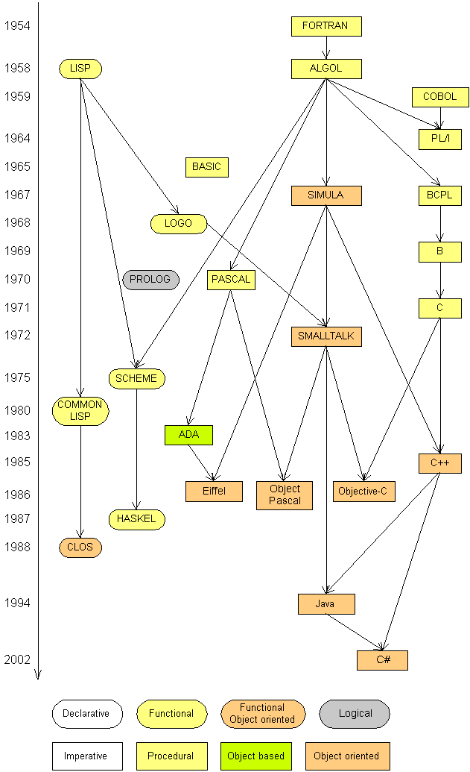
Programming languages
procedural languages: programs are a series of commands
Pascal (1970): designed for education
C (1972): low-level operating systems and devices
functional programming: functions map inputs to outputs
Lisp (1958) / Scheme (1975), ML (1973), Haskell (1990)
object-oriented languages: programs use interacting "objects"
Smalltalk (1980): first major object-oriented language
C++ (1985): "object-oriented" improvements to C
successful in industry; used to build OSes such as Windows
Java (1995): designed for embedded systems, web apps
Runs on many platforms (Windows, Mac, Linux, cell phones...)
The language taught in this course and our textbook

Slide 42
Karel's World
3
.
.
.
.
.
2
.
.
.
.
.
1
.
.
.
.
.
1
2
3
4
5

Slide 43
Karel's World
3
.
.
.
.
.
2
.
.
.
.
.
1
.
.
.
.
.
1
2
3
4
5

Slide 44
Karel's World
3
.
.
.
.
.
2
.
.
.
.
.
Hello, world!
1
.
.
.
.
.
1
2
3
4
5

Slide 45
Karel's World
3
.
.
.
.
.
2
.
.
.
.
.
1
.
.
.
.
.
1
2
3
4
5

Slide 46
Streets (rows)
3
.
.
.
.
.
2
.
.
.
.
.
1
.
.
.
.
.
1
2
3
4
5
Each row is called a street.

Slide 47
Avenues (columns)
3
.
.
.
.
.
2
.
.
.
.
.
1
.
.
.
.
.
1
2
3
4
5
Each column is called an avenue.

Slide 48
Corners (locations)
3
.
.
.
.
.
2
.
.
.
.
.
1
.
.
.
.
.
The intersection of a street and an avenue is a corner.
1
2
3
4
5

Slide 49
Walls
3
.
.
.
.
.
2
.
.
.
.
.
1
.
.
.
.
.
1
2
3
4
5
Karel cannot move through walls.

Slide 50
Beepers
3
.
.
.
.
.
2
.
.
.
.
.
1
.
.
.
.
.
Beepers mark locations in Karel's world. Karel can pick them up and put them down.
1
2
3
4
5

Slide 51

Karel Knows 4 Commands
move
turnLeft
putBeeper
pickBeeper

Slide 52
Karel commands: move
move makes Karel move forward one square in the direction it is facing.
Karel Commands
3
.
.
.
.
.
move
turnLeft
pickBeeper
putBeeper
2
.
.
.
.
.
1
.
.
.
.
.
.
1
2
3
4
5

Slide 53
Commands: turnLeft
turnLeft makes Karel rotate 90° counter-clockwise.
There is no turnRight command. (Why not?)
Karel Commands
3
.
.
.
.
.
move
turnLeft
pickBeeper
putBeeper
2
.
.
.
.
.
1
.
.
.
.
.
.
1
2
3
4
5

Slide 54
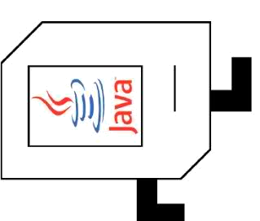
Commands: pickBeeper
pickBeeper makes Karel pick up the beeper at the current corner. Karel can hold multiple beepers at a time in its "beeper bag".
Karel Commands
3
.
.
.
.
.
move
turnLeft
pickBeeper
putBeeper
2
.
.
.
.
.
1
.
.
.
.
.
.
1
2
3
4
5

Slide 55
Commands: putBeeper
putBeeper makes Karel put a beeper down at its current location.
pickBeeper and putBeeper are used to move beepers around.
Karel Commands
3
.
.
.
.
.
move
turnLeft
pickBeeper
putBeeper
2
.
.
.
.
.
1
.
.
.
.
.
.
1
2
3
4
5

Slide 56
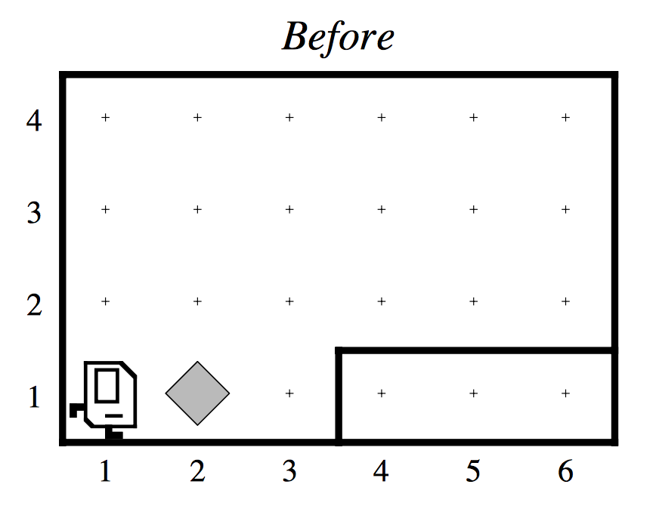
Our First Karel Program

Slide 57
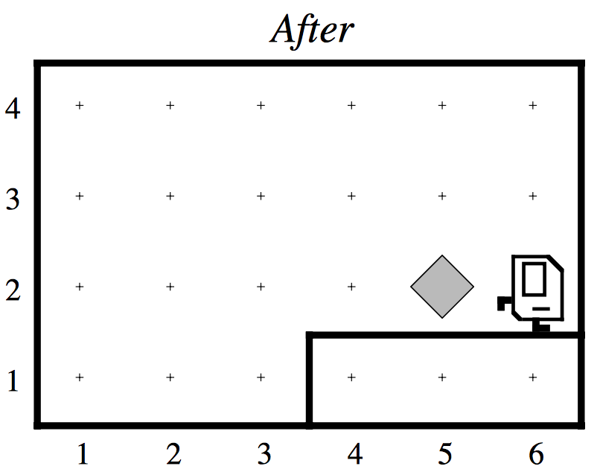
Our First Karel Program

Slide 58
Karel Summary
Karel lives in a grid world with walls and beepers.
4 commands: move, turnLeft, pickBeeper and putBeeper.
Seems simple; but you can do amazing things with Karel!

Slide 59
Wrap-up
Introduction √
Course Policies √
Meet Karel the Robot √
Next time: more programming with Karel!

